Slide 1

Title: TradeWise: Stock Performance Analysis
Name: Chandni Kalchuri
Date: 24-08-2026

Slide 2

Introduction to TradeWise
The Market Context: The Nifty 50 represents the core of the Indian equity market. However, successfully navigating its volatility requires data-driven systems, not just intuition.
Project Overview: "TradeWise" is an analytical project designed to backtest historical price data for the Top 20 Nifty 50 stocks using algorithmic trading principles.

Slide 3

Primary Objectives
Analyze Historical Data: Process and clean 5-year historical stock data to extract meaningful trends.
Implement Trading Strategy: Backtest a systematic 20-Day vs. 50-Day Moving Average (MA) Crossover strategy.
Evaluate Performance: Calculate key metrics including Total Returns, Maximum Drawdown, and Sharpe Ratio.
Strategic Recommendations: Identify the most robust stocks to formulate a data-backed investment portfolio.

Slide 4

Data Overview
Dataset Scope: The analysis utilizes 5 years of historical daily price data specifically filtered for the Top 20 stocks within the Nifty 50 index.
Key Variables: The dataset includes essential market metrics such as Open, High, Low, Close, Adjusted Close, Volume, and VWAP (Volume Weighted Average Price).
Data Cleaning & Preprocessing:
  Handled missing values and eliminated data inconsistencies.
  Ensured strict chronological order, which is mandatory for accurate time-series analysis.
Significance: High-quality, continuous data is critical for calculating precise 20-day and 50-day moving averages and generating reliable algorithmic trading signals.

Slide 5

Analytical Approach & Methodology
Tools Utilized: Employed Python as the primary analytical tool, utilizing Pandas for complex data manipulation and aggregations, along with Matplotlib and Seaborn for dynamic data visualization.
Algorithmic Strategy: Designed and backtested a trend-following system using a 20-day (Short-term) and 50-day (Long-term) Simple Moving Average (SMA) to autonomously generate Buy and Sell signals.
Performance Evaluation: Quantified strategy success by calculating critical risk-reward metrics, primarily Total Returns, Annualized Returns, Maximum Drawdown, and the Sharpe Ratio.
Visual Analysis: Created pair plots, scatter plots, and correlation heatmaps to uncover hidden patterns, inter-stock relationships, and volatility trends across the Top 20 stocks.

Slide 6
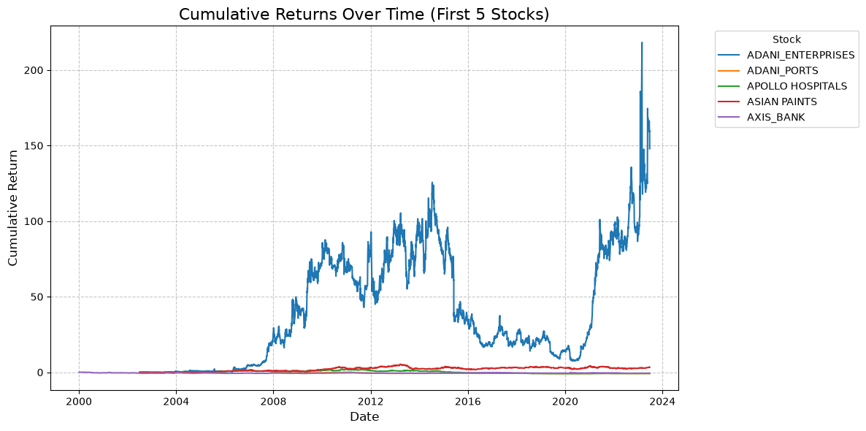
Long-Term Wealth Compounding
Key Insights:
Exponential Growth: ADANI_ENTERPRISES demonstrated an exceptional compounding effect, massively outperforming the other top stocks over the analyzed period.
Performance Disparity: There is a significant disparity in long-term wealth generation even among the top-tier Nifty 50 stocks.
Flat Trajectories: While one asset surged, the remaining four stocks exhibited relatively flat or slow-growing trajectories, emphasizing the need for careful stock selection.
Figure 1: Cumulative Returns Over Time (First 5 Stocks)

Slide 7
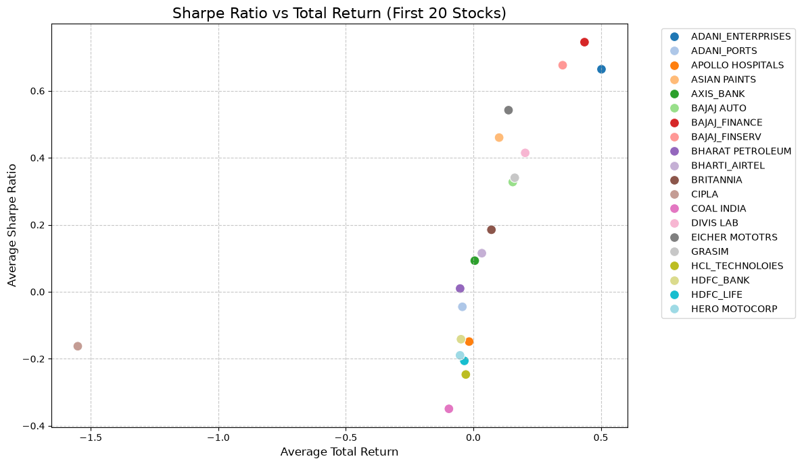
Risk vs. Reward Efficiency
Key Insights:
Positive Correlation: There is a strong positive correlation between Total Return and the Sharpe Ratio across the analyzed stocks.
Optimal Performers: Stocks positioned in the top-right quadrant (e.g., BAJAJ_FINANCE, ADANI_ENTERPRISES) offer the most efficient risk-adjusted returns.
Maximizing Profitability: These leading assets successfully maximize long-term profitability relative to the volatility (risk) endured by the investor.
Figure 2: Sharpe Ratio vs Total Return

Slide 8
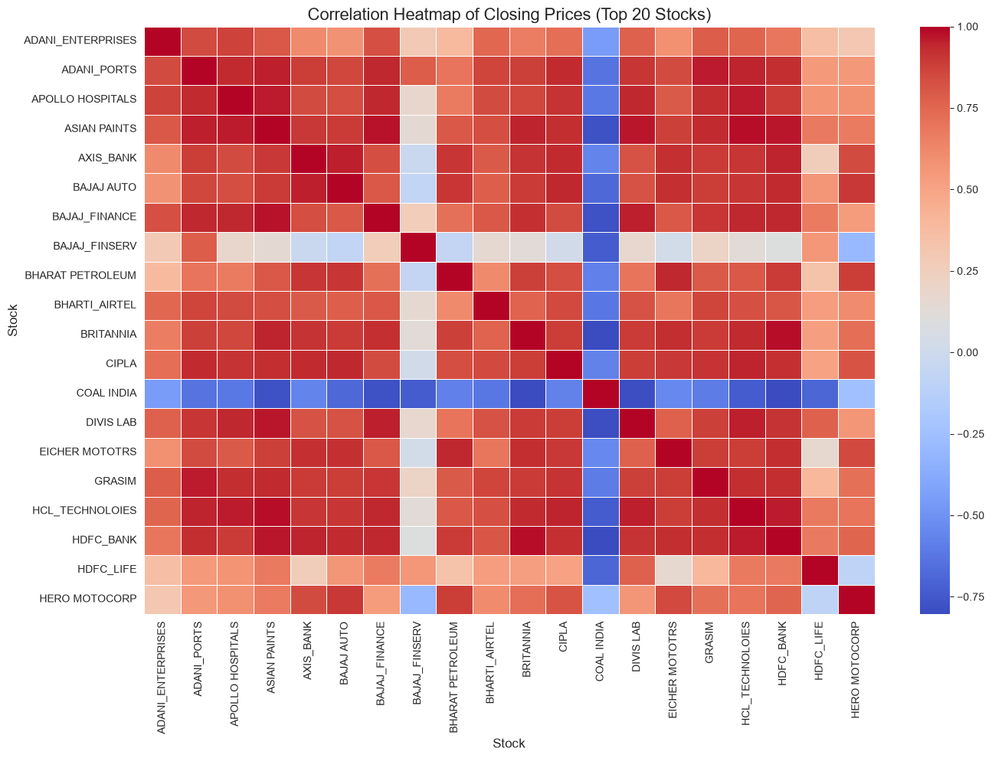
Market Correlation & Portfolio Hedging
Strategic Insights:
Widespread Positive Correlation: Most top 20 stocks move in tandem (warm colors), heavily driven by broader market trends.
The "COAL INDIA" Anomaly: Uniquely exhibits a strong negative correlation (dark blue band) with almost all other stocks on the list.
Diversification Value: Because it moves inversely to the majority, COAL INDIA acts as a strategic hedge, offering portfolio stability during broader market downturns.
Figure 3: Correlation Heatmap

Slide 9
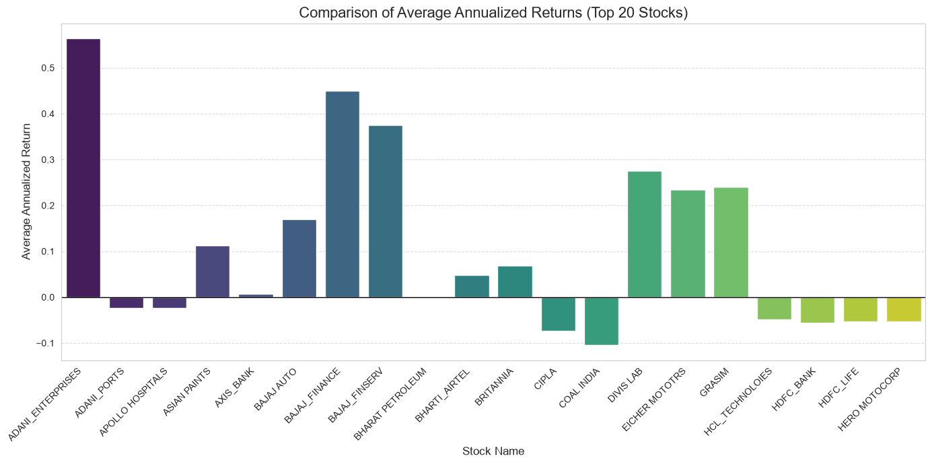
Annualized Returns Comparison
Key Insights:
Performance Disparity: The bar chart reveals a massive gap in annualized returns among the top 20 stocks.
Compounding Leaders: Assets like ADANI_ENTERPRISES show exceptionally high positive annualized returns, ideal for long-term wealth compounding.
Portfolio Drags: Conversely, stocks with flat or negative returns (e.g., COAL INDIA) highlight the importance of portfolio pruning.
Figure 4: Comparison of Average Annualized Returns

Slide 10
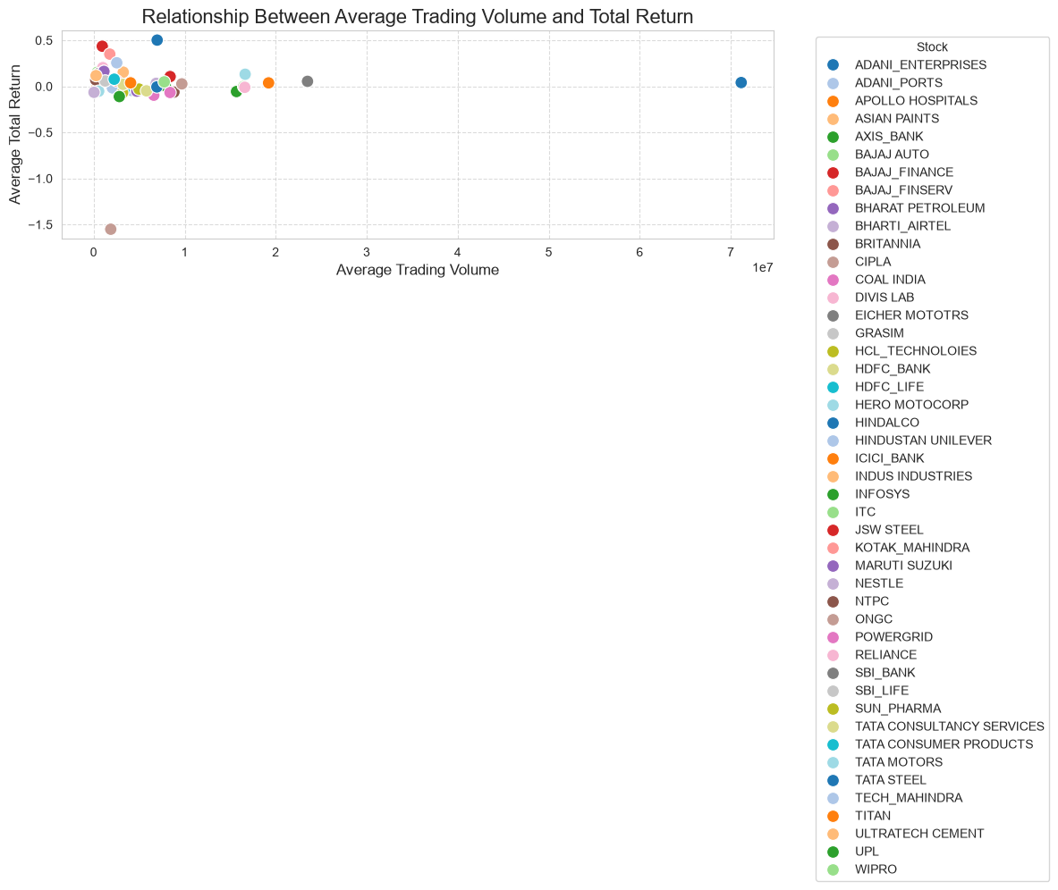
Liquidity vs. Profitability
Key Insights:
Weak Correlation: The plot indicates almost no direct correlation between high trading volume and high total returns.
Concentration of High Returns: The highest returning stocks are clustered in the lower-to-mid volume range.
Actionable Takeaway: Trading volume should only be used to confirm market liquidity (ease of trading), not as a predictive indicator for future outsized gains.
Figure 5: Relationship Between Average Trading Volume and Total Return

Slide 11
Evaluating the MA Crossover Strategy
Key Findings from Backtesting:
Divergent Outcomes: The 20/50 SMA strategy yielded substantial returns for strongly trending stocks (e.g., ADANI_ENTERPRISES) but triggered false signals ("whipsaws") in sideways or choppy markets.
Drawdown Vulnerability: The inherent lag of the 50-day moving average meant initial steep drops were absorbed before a 'Sell' signal triggered, failing to fully protect capital during sudden crashes.
Strategic Recommendation:
Enhance Risk Management: Relying strictly on a basic moving average crossover is insufficient. It is highly recommended to integrate a trailing stop-loss mechanism to exit trades earlier during market shocks, thereby improving the Sharpe Ratio and preserving capital.

Slide 12
Final Investment Recommendations
The Blended Portfolio Strategy:
For Aggressive Growth: Allocate a higher percentage to ADANI_ENTERPRISES and BAJAJ_FINANCE. These assets consistently demonstrated the optimal balance of high returns and strong risk-adjusted performance (Sharpe Ratio).
For Capital Preservation: Include defensive stocks like NESTLE. Its exceptionally low maximum drawdown provides a critical cushion, protecting the overall portfolio during severe market crashes.
For Strategic Hedging: Utilize inversely correlated assets like COAL INDIA. Because it moves against the broader market trends, it acts as a stabilizer for the portfolio's volatility.

Slide 13
Actionable Strategic Recommendations
Refine the Trading Strategy: The 20/50 Moving Average crossover is profitable for trending stocks but fails in choppy markets. Recommendation: Add a strict percentage-based stop-loss to the strategy to prevent massive drawdowns during sudden market crashes.
Smart Diversification: Avoid over-concentrating in highly correlated stocks from the same sector (e.g., holding both BAJAJ_FINANCE and BAJAJ_FINSERV), which doubles portfolio risk.
Leverage Anomalies: Actively use inversely correlated stocks (like COAL INDIA) as a portfolio hedge. When the broader market dips, these assets can stabilize overall portfolio value.

Slide 14
Conclusion
Growth Potential: Identified top-performing Nifty 50 stocks (e.g., ADANI_ENTERPRISES) that provide exceptional long-term wealth compounding opportunities.
Risk & Stability: Revealed that high returns come with significant drawdowns, advocating for the inclusion of highly stable, defensive stocks like NESTLE.
Data-Driven Execution: Our comprehensive backtesting proves that combining high-growth assets with strong risk management (stop-losses) and inversely correlated hedges creates an optimized, resilient investment strategy.
Closing Statement:
  "The insights gathered are not just numbers—they form the definitive roadmap for navigating the Nifty 50 with confidence and precision."

Slide 15


